Slide 1
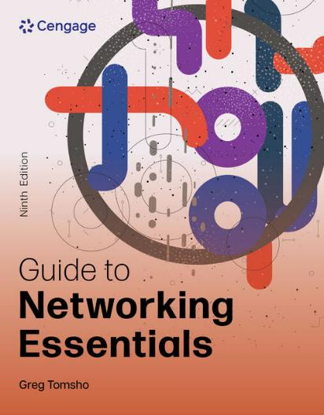
Guide to Networking Essentials, 9e
Chapter 9: Introduction to Network Security
.

Slide 2
Chapter Objectives
By the end of this chapter, you should be able to:
Develop a network security policy
Secure physical access to network equipment
Secure access to network data
Describe network security devices
Protect a network from malware
Discover network vulnerabilities

Slide 3
Network Security Overview and Policies
Network security should be as unobtrusive as possible
It should allow network users to concentrate on the tasks they want to accomplish rather than how to get to the data they need to perform those tasks
Having a secure network enables an organization to go about its business confidently and efficiently
A company that can demonstrate its information systems are secure is more likely to attract customers, partners, and investors

Slide 4
Developing a Network Security Policy
A network security policy is a document that describes the rules governing access to a company’s information resources, enforcement of these rules, and steps taken if rules are breached
A security policy should:
Be easy for ordinary users to understand and reasonably comply with
Be enforceable
Example: You shouldn’t forbid Internet use during a certain time of day unless you have a method of monitoring or restricting this use
Clearly state the objective of each policy so that everyone understands its purpose

Slide 5
Determining Elements of a Network Security Policy (1 of 2)
Basic items needed in order to start writing your security policy:
Privacy policy—Describes what staff, customers, and business partners can expect for monitoring and reporting
Acceptable use policy—Explains for what purposes network resources can be used
Authentication policy—Describes how users identify themselves to gain access to network resources
Internet use policy—Explains what constitutes proper or improper use of Internet resources

Slide 6
Determining Elements of a Network Security Policy (2 of 2)
Basic items needed in order to start writing your security policy (continued):
Access policy—Specifies how and when users are allowed to access network resources
Auditing policy—Explains the manner in which security compliance or violations can be verified and the consequences for violations
Data protection policy—Outlines the policies for backup procedures, virus protection, and disaster recovery

Slide 7
Understanding Levels of Security (1 of 4)
Before determining the level of security your network needs, answer these questions:
What must be protected?
From whom should data be protected?
What costs are associated with a breach and data being lost or stolen?
How likely is it that a threat will actually occur?
What’s the likelihood of a natural disaster?
Are the costs to implement security and train personnel outweighed by the need to create an efficient, user-friendly environment?

Slide 8
Understanding Levels of Security (2 of 4)
Level 3—Maximum Protection Security Policies
Level 3 security is for organizations that are subject to targeted attacks
A targeted attack is a carefully planned network attack campaign, also an advanced persistent threat (APT)
These organizations will have a dedicated security department and will likely work with a managed security service provider (MSSP)
An MSSP is a third-party security organization that provides security services to organization and likely includes 24/7 monitoring, intrusion detection and prevention, and security information and event management (SIEM)

Slide 9
Understanding Levels of Security (3 of 4)
Level 2—Advanced Protection Security Policies
Level 2 security is designed to protect the network from non-targeted attacks
It requires auditing geared toward detecting unauthorized logon attempts, misuse of network resources, and network attacker activity
A network attacker is a person who attempts to break into a network
Level 1—Minimal Protection Security Policies
Level 1 security is to prevent the most common types of cyber threats
Small, unregulated businesses are likely to opt for this type of security

Slide 10
Understanding Levels of Security (4 of 4)
Common Elements of Security Policies
Antivirus and other malware protection for servers and desktops
Backup procedures
Physical security of servers and network devices

Slide 11
Physical Security Best Practices (1 of 3)
Best practices to secure your network from physical assault:
Ensure that rooms are available to house servers and equipment
Rooms should have locks, adequate power receptacles, adequate cooling measures, and an EMI-free environment
If a suitable room is not available, locking cabinets can be purchased to house servers and equipment in public areas
Wiring from workstations to wiring cabinets should be inaccessible to eavesdropping equipment
Your physical security plan should include procedures for recovery from natural disasters such as fire or floods

Slide 12
Physical Security Best Practices (2 of 3)
Physical Security of Servers
Servers often require more tightly controlled environmental conditions than patch panels and switches do
Servers can generate a lot of heat and need adequate cooling
Lack of cooling can cause damage to hardware components
Power to the server should be on a separate circuit from other devices
Verify power requirements for UPSs—some UPSs require special twist-lock outlet plugs rated for high currents
If servers are placed in a public access area, locking cabinets are a must

Slide 13
Physical Security Best Practices (3 of 3)
Security of Internetworking Devices
Routers and switches contain critical configuration information
A user with physical access to these devices needs only a laptop or handheld computer to get into the router or switch
Configuration changes made to routers and switches can have disastrous results
A room with a lock is the best place for internetworking devices
A wall-mounted enclosure with a lock is the next best thing

Slide 14
Securing Access to Network Data
Data security concepts include: confidentiality, integrity, and availability
Securing data on a network has many facets:
Authentication and authorization
Encryption
Virtual private networks (VPNs)
Wireless security
Network security devices
Malware protection

Slide 15
Authentication and Authorization (1 of 8)
Authentication and authorization enable administrators to control who has access to the network (authentication) and what users can do after they are logged on to the network (authorization)
Authentication protocols offer varying levels of secure authentication:
Kerberos—Used in a Windows domain environment and provides mutual authentication
Remote Authentication Dial In User Service (RADIUS)—an industry-standard client/server protocol that offers centralized control
Extensible Authentication Protocol (EAP)—a framework for other protocols that provide encryption and authentication

Slide 16
Authentication and Authorization (2 of 8)
Authentication protocols offer varying levels of secure authentication (continued):
Microsoft Challenge Handshake Authentication Protocol version 2 (MS-CHAP v2)—a mutual authentication protocol
Microsoft Challenge Handshake Authentication Protocol (MS-CHAP)—an earlier version
Password Authentication Protocol (PAP)

Slide 17
Authentication and Authorization (3 of 8)
Multifactor Authentication (MFA) requires a user to supply two or more types of authentication drawn from these credential categories:
Knowledge—what the user knows (username/password)
Possession—what the user has (smart card or key)
Inherence—what the user is; a unique biometric identifying trait
Windows OSs allows passwords up to 128 characters
A minimum of five to eight characters is typical
Other password options include: maximum password age, minimum password age, and enforce password history

Slide 18
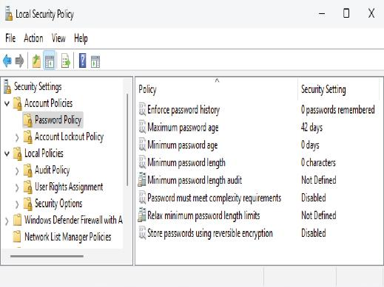
Authentication and Authorization (4 of 8)
Figure 9-1 Password policy settings in Windows 11

Slide 19
Authentication and Authorization (5 of 8)
Password Dos and Don’ts include the following:
Use a combination of uppercase letters, lowercase letters, numbers, and special characters
Consider using a phrase, such as NetW@rk1ng!sC00l
Don’t use passwords based on your logon name, your family members’ or pets’ names
Don’t use common dictionary words unless they are part of a phrase
Don’t make your password so complex that you forget it unless you are using a password manager

Slide 20
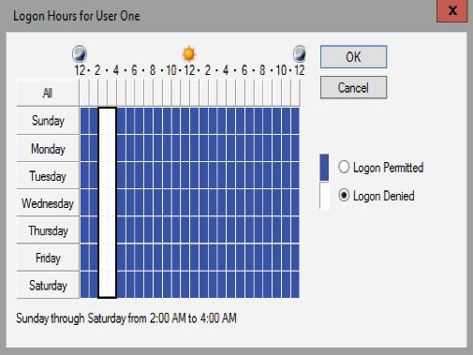
Authentication and Authorization (6 of 8)
Figure 9-2 Setting logon hours for a user
Most OSs have solutions to restrict logon time by time of day, day of week, and location.

Slide 21
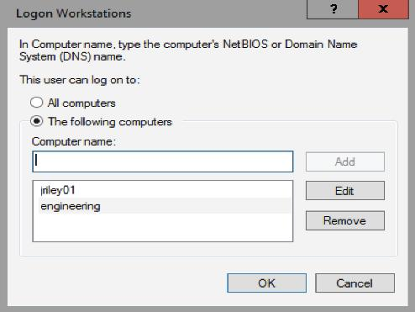
Authentication and Authorization (7 of 8)
Figure 9-3 The Logon Workstations dialog box
Users can be restricted to logging on only from particular workstations.

Slide 22
Authentication and Authorization (8 of 8)
Authorizing Access to Files and Folders
File system security allows administrators to assign file and folder permissions to users or groups
Permissions define the level of access a user has to the file system
File and folder permissions are a necessary tool administrators use to make network resources secure
The principle of least privilege (PoLP) is a security concept that states users should have only the necessary permission to perform their jobs
Permissions don’t protect data traversing the network media

Slide 23
Securing Data with Encryption (1 of 3)
Encryption prevents people from using eavesdropping technology, such as a protocol analyzer (packet sniffer), to capture packets
Data can also be secured with encryption to prevent someone who has gained physical access to a computer from being able to use the data
Familiarize yourself with the terms listed in the text

Slide 24
Securing Data with Encryption (2 of 3)
Using IPsec to Secure Network Data
The most widely used method for encrypting data is using IP Security (IPsec)
An association is formed by two devices authenticating their identities via a preshared key, Kerberos authentication, or digital certificates
A preshared key is series of letters, numbers, and special characters that two devices use to authenticate each other’s identity (an administrator enters the same key in the IPsec settings on both devices)

Slide 25
Securing Data with Encryption (3 of 3)
Securing Data on Disk Drives
In Windows OSs, Encrypting File System (EFS) is used to encrypt files or folders
EFS works in one of three modes:
Transparent mode
USB key mode
User authentication mode
BitLocker is a good security enhancement for servers that aren’t physically secure and for mobile devices at risk of being lost or stolen

Slide 26
Securing Communication with Virtual Private Networks (1 of 4)
A virtual private network (VPN) uses the Internet to give users or branch offices secure access to a company’s network resources
VPNs use encryption technology to ensure the communication is secure while traveling through the public Internet
A “tunnel” is created between the VPN client and VPN server
VPN servers can be configured on server OSs or they can be in the form of a dedicated device, such as a VPN concentrator or VPN router, with the sole purpose of handling VPN connections

Slide 27
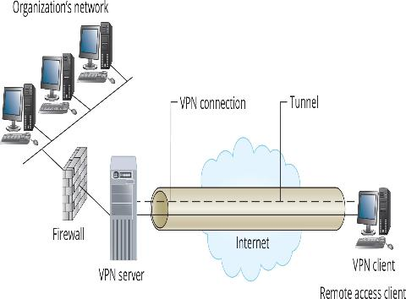
Securing Communication with Virtual Private Networks (2 of 4)
Figure 9-4 A typical VAN connection

Slide 28
Securing Communication with Virtual Private Networks (3 of 4)
Windows server OSs include a VPN server solution with the Remote Access server role
Windows supports three implementations of VPN:
Point-to-Point Tunneling Protocol (PPTP)—A commonly used VPN protocol in Windows OSs with client support for Linux and Mac OS X
Layer 2 Tunneling Protocol with IPsec (L2TP/IPsec)—Provides a higher level of security than PPTP and provides data integrity as well as identity verification
Secure Socket Tunneling Protocol (SSTP)—Works behind most firewalls, firewall administrators do not need to configure the firewall to allow VPN

Slide 29
Securing Communication with Virtual Private Networks (4 of 4)
VPN Remote Access Modes
Two VPN modes are available with most VPN servers:
Site-to-site VPN mode—a VPN connection is established between two VPN devices
Client-to-site VPN mode—establishes a VPN connection between a single client computer and a VPN device
When shopping for a router that supports VPN connections from remote clients, look for one that supports VPN tunnels

Slide 30
Securing Wireless Networks (1 of 2)
Part 2
Anyone with a wireless scanner and some software who gets within range of a wireless network’s signals can intercept data
Wardrivers are attackers who drive around looking for wireless LANs (WLANs) to intercept
Wireless security must be enabled on all your devices by using one or more of the following methods:
Wireless encryption
Wi-Fi Protected Access 2 (WPA2), Wi-Fi Protected Access (WPA), and Wired Equivalent Privacy (WEP)

Slide 31
Securing Wireless Networks (2 of 2)
Wireless security must be enabled on all your devices by using one or more of the following methods (continued):
MAC address filtering—If your network is small, you can use the MAC address filtering feature on APs to restrict network access to computers with specific MAC addresses
Service set identifier (SSID)—An SSID is an alphanumeric label configured on the access point
Each client must configure its wireless NIC for that SSID to connect to that access point
Wi-Fi Protected Setup (WPS)

Slide 32
Knowledge Check Activity 9-1
Which of the following is true about physical security?
a. A strong password can replace physical security.
b. It’s not necessary to secure network cabling.
c. Two-factor authentication for server room access is recommended.
d. Server rooms should have false ceilings to accommodate air flow.

Slide 33
Knowledge Check Activity 9-1: Answer
Which of the following is true about physical security?
Answer: c. Two-factor authentication for server room access is recommended.
Explanation: When planning your network, make sure rooms are available to house servers and equipment. These rooms should have locks to prevent unauthorized access and be suitable for the equipment being housed. For server and equipment rooms, two-factor authentication such as a key card and a PIN is recommended.

Slide 34
Network Security Devices
Routers can provide a layer of network security by using access control lists (ACLs)
However, a router’s main job is to route packets and control access to resources on an internetwork
To protect against threats from external networks:
Use specialized devices on the network perimeter, which is the boundary between your network and external networks such as the Internet
Firewalls and intrusion detection and prevention systems are examples

Slide 35
Protecting Network with Firewalls (1 of 3)
A firewall is a hardware device or software program that inspects packets going into or out of a network or computer, then discards or forwards these packets based on a set of rules
A hardware firewall is configured with two or more network interfaces, typically placed between a corporate LAN and the WAN connection
A software firewall is installed in an OS and inspects all packets coming into or leaving the computer
Firewalls protect against outside attempts to access resources and malicious packets intended to disable a network

Slide 36
Protecting Network with Firewalls (2 of 3)
Firewalls can also be used to restrict users’ access to Internet resources
After installed, the administrator must build rules that allow only certain packets to enter or exit the network
Can be based on source and destination addresses, protocols such as IP, TCP, ICMP, and HTTP
Firewalls can also attempt to determine a packet’s context (a process called stateful packet inspection or SPI)
Firewalls can examine actual data in a packet and filter packets containing malicious data (this type of firewall is called a content filter)

Slide 37
Protecting Network with Firewalls (3 of 3)
Routers can be used as firewalls
Network administrators can create rules, called access control lists (ACLs) that deny certain types of packets
Using Network Address Translation to Improve Security
Because most networks use Network Address Translation (NAT) with private IP addresses, devices configured with private IP addresses can’t be accessed directly from outside the network
When NAT is used, an external device can’t initiate a network conversation with an internal device

Slide 38
Using Intrusion Detection and Prevention Systems (1 of 3)
An intrusion detection system (IDS) monitors network traffic for malicious packets or traffic patterns
An IDS can be:
Network-based (NIDS), which protects an entire network and can be placed on the network perimeter
Host-based (HIDS), which is a software application used to protect a single computer (usually a server)
Can be installed on a honeypot, which is a device installed as a decoy to lure potential attackers

Slide 39
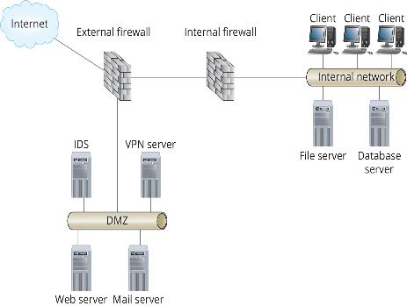
Using Intrusion Detection and Prevention Systems (2 of 3)
Figure 9-7 A DMZ with a network-based IDS

Slide 40
Using Intrusion Detection and Prevention Systems (3 of 3)
An intrusion prevention system (IPS) can take countermeasures if an attack is in progress
Countermeasures can include:
Reconfiguring a firewall to prevent suspicious packets from entering the network
Resetting the connection between source and destination devices
Disabling the link between inside and outside networks

Slide 41
Protecting a Network from Malware
Malware is any type of software that presents a nuisance to users or a threat to the integrity of a system or network
Examples of how users can bring viruses or other malware into the network:
Downloading programs
Bringing files from home
Opening e-mail attachments
Browsing unsafe Web sites

Slide 42
Viruses
A virus is a program that spreads by replicating itself into other programs or documents
Types of viruses include the following:
File infector virus
Boot sector virus
Polymorphic virus
Macro virus
Overwrite virus
Browser hijacker virus

Slide 43
Worms
A worm is a type of malware that doesn’t require another file to spread to other computers
It’s a self-contained program that just needs a computer to be connected to a network
Worms are commonly spread by e-mail attachments, instant messaging, IRC channels, and network file sharing
Worms can also create a backdoor, which is a program installed on a computer that permits access to the computer, bypassing normal authentication process

Slide 44
Other Forms of Malware
A Trojan horse is malware that appears to be something useful, such as a free utility, but in reality contains some type of malware
A rootkit is a form of malware that can monitor traffic to and from a computer, monitor keystrokes, and capture passwords
A hoax virus uses a tactic called social engineering, in which attackers get users to do their bidding without being aware of the consequences
A logic bomb is time-dependent malware that’s activated when a particular event occurs

Slide 45
Spyware, Spam, and Phishing
Spyware is a type of malware that monitors or controls part of your computer at the expense of your privacy
Spyware usually decreases your computer’s performance and increases pop-up Internet messages
Spam is unsolicited e-mail that takes up e-mail storage space, network bandwidth and people’s time
Phishing uses social engineering tactics to coax a person into sending the attacker personal information, logon information, and possibly money

Slide 46
Malware Protection
Every desktop and server should have antimalware software running
Should include antivirus software and antispyware
A virus scanner residing in memory should be used so that every program file or document that’s accessed is scanned
Microsoft includes Windows Defender with current versions
It contains both antivirus and antispyware protection
It is installed and enabled by default and updated automatically on a regular basis

Slide 47
Tools to Discover Network Security Vulnerabilities
The attacker attempts to break into a network system
The penetration tester attempts to break into a system to advise the owners of the system where vulnerabilities lie
They are often referred to as an ethical hacker
In cybersecurity, there are two adversaries:
The red team is tasked with defeating security controls and accessing or disabling a system
The blue team is tasked with defending against the red team’s attempts

Slide 48
Discovering Network Resources (1 of 3)
Attackers use command-line utilities to discover your network:
Ping, tracert, finger, and nslookup are some utilities used
A ping scanner is an automated method for pinging a range of IP addresses
A port scanner determines which TCP and UDP ports are available on a particular computer or device
Whois is a utility for discovering information about an Internet domain
Information that can be gathered from a Whois query includes IP address information and names and addresses of DNS servers used by that domain

Slide 49
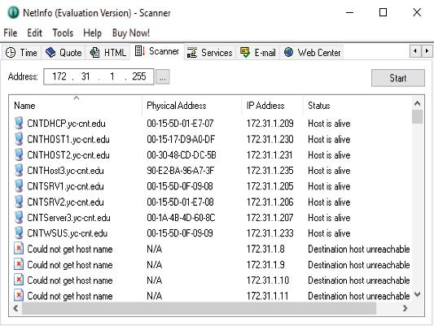
Discovering Network Resources (2 of 3)
Figure 9-11 The results of a ping scan on a network

Slide 50
Discovering Network Resources (3 of 3)
Protocol analyzers enable you to capture packets and determine which protocol services are running
They require access to the network media
The use of the finger utility can be disabled by turning it off on all UNIX, Linux servers and routers
A port scan should be run on all network devices to see what services are on, and then services that aren’t necessary should be turned off
To protect against the use of protocol analyzers, all hubs and switches should be secured in a locked room or cabinet

Slide 51
Gaining Access to Network Resources
After an attacker has discovered the resources available, the next step might be gaining access
Attackers will try to gain access via devices that have no password set
finger can be used to discover usernames
Linux and Windows servers have default administrator names that are often left unchanged
An attacker with a password-cracking tool can easily exploit
Using a password-cracking tool on your own system is recommended to see whether your passwords are complex enough

Slide 52
Disabling Network Resources (1 of 2)
A denial-of-service (DoS) attack is an attacker’s attempt to tie up network bandwidth or network services
Three common types of DoS attacks include the following
Packet storms use the UDP protocol to send UDP packets that have a spoofed address, causing the host to be unavailable to respond to packets
Half-open SYN attacks use the TCP three-way handshake to tie up a server with invalid TCP sessions
A ping flood sends a large number of ping packets to a host
They cause the host to reply, typing up CPU cycles and bandwidth

Slide 53
Disabling Network Resources (2 of 2)
Distributed denial-of-service (DDoS) attacks use many systems to attack a single network or resource
Firewalls, access lists, virus scanners, and strong OS security are some ways to prevent attacks or reduce their effects
Regardless of your tools, always start by devising a sound security policy that maps out your overall network security plan

Slide 54
Knowledge Check Activity 9-2
What tool should you use if you want to know what network services are running on a computer?
a. Ping scanner
b. Port scanner
c. Trace route
d. Finger

Slide 55
Knowledge Check Activity 9-2: Answer
What tool should you use if you want to know what network services are running on a computer?
Answer: b. Port scanner
Explanation: A ping scanner is an automated method for pinging a range of IP addresses. A port scanner determines which TCP and UDP ports are open on a computer or device which can tell you what network services are enabled on a computer. Trace route is used to see the route packets take through an internetwork, and finger is used to discover the accounts that are signed into the network.

Slide 56
Self Assessment
Describe the type of organization who would benefit from each of the 3 levels of security.
If network administrators want to be informed when an attempt has been made to compromise the network, what should they use?
deltacollege.edu
https://dnschecker.org/all-tools.php

Slide 57
Summary
Now that the lesson has ended, you should be able to:
Develop a network security policy
Secure physical access to network equipment
Secure access to network data
Describe network security devices
Protect a network from malware
Discover network vulnerabilities

